Slide 1
Optimizing Sales Strategies and Enhancing Customer Experience

Slide 2
Problem Statement
The primary objective of this project is to conduct an integrated analysis of multidimensional datasets to optimize sales strategies and enhance customer experience. By synthesizing insights from sales data, customer feedback, operational metrics, and market dynamics.
The aim is to identify actionable recommendations that drive revenue growth, improve customer satisfaction, and streamline operational processes.

Slide 3
Analysis Objectives:
1.Sales Performance Analysis:
Evaluate sales trends over time, by channel, country, and geographic region.
Assess the impact of discount strategies on sales volume and profitability.
Analyze adherence to sales targets and identify areas for improvement.
Identify high-performing products, sales channels, and geographic regions.
2. Customer Satisfaction and Experience:
Explore factors influencing customer satisfaction, including complaints and returns.
Analyze return rates and their implications on profitability and customer retention.
Evaluate customer satisfaction levels across different regions and product categories.
Identify trends in customer feedback and sentiments to improve service quality.

Slide 4
Analysis Objectives:
3. Product Performance and Market Trends:
Analyze product sales performance by category, brand, and class.
Evaluate the effectiveness of different discount types and percentages on product sales.
Identify market trends and customer preferences influencing product demand.
Assess product profitability and pricing strategies to maximize revenue.
4. Sales Channel and Distribution Analysis:
Analyze the effectiveness of different sales channels and channel types.
Identify high-performing sales channels and optimize resource allocation.
Evaluate the geographic distribution of sales and identify opportunities for expansion.
Assess the alignment of sales channels with customer preferences and market demand.

Slide 5
Analysis Objectives:
5. Operational Efficiency and Target Achievement:
Evaluate the company's performance against sales targets set for different time periods.
Identify factors contributing to target achievement or shortfall.
Analyze operational efficiency in handling complaints, returns, and customer inquiries.
Identify opportunities to streamline processes and improve resource allocation.
6. Strategic Planning and Decision-Making:
Provide actionable insights and recommendations for optimizing sales strategies.
Identify opportunities for product innovation, pricing adjustments, and market expansion.
Inform decision-making processes related to inventory management, marketing campaigns, and customer service initiatives.
Support strategic planning efforts to drive sustainable growth and competitive advantage.

Slide 6
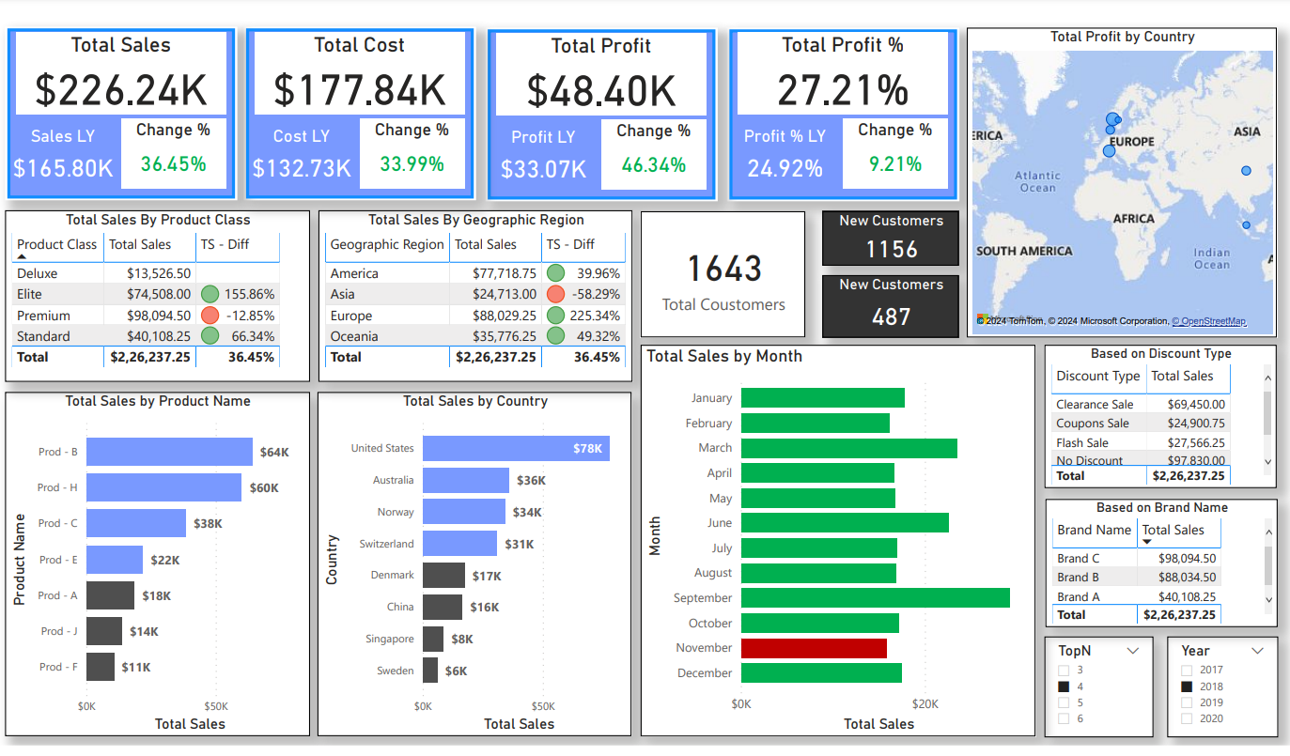

Slide 7
Sales Overview Insights
Overall sales are up 36.45% year-over-year. This is a positive sign, but it's important to note that sales growth has slowed down from 46.34% last year.
The company's profit margin is 27.21%. This is a healthy profit margin, but it's down from 29.92% last year.
Sales are growing in all regions except Asia. Sales in Asia are down 58.29% year-over-year.
The Deluxe product class is the company's best-seller, but sales are down 12.85% year-over-year. The Premium product class is growing the fastest, with sales up 98.09% year-over-year.
The company is acquiring new customers at a rapid pace. The number of new customers is up 1643 year-over-year.
The most popular discount type is "No Discount," followed by "Clearance Sale" and "Coupons Sale."
The top-selling product is Prod-B, followed by Prod-H and Prod-C.
The company's sales are concentrated in the United States, Australia, and Switzerland.

Slide 8
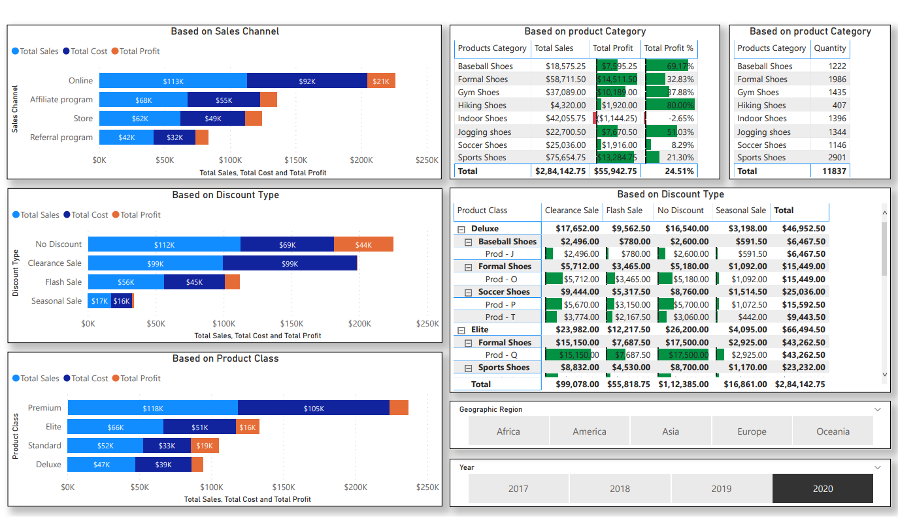

Slide 9
Sales Analysis
Sales and profit
Total sales for the year are $528,414.25. This is down from $551,568.75 last year, a decrease of 4.20%.
Total profit is $128,385. This is also down from $160,352.50 last year, a decrease of 20.04%.
The profit margin is 24.51%. This is lower than last year's 29.07%.
Sales by channel
The online channel is the largest source of sales, generating $113,000 in revenue. This is followed by the affiliate program at $55,000 and the store at $63,000.
The referral program generated the highest profit margin at 21.30%, followed by the store at 18.18% and the affiliate program at 15.45%.
The online channel had the lowest profit margin at 1.07%.

Slide 10
Sales Analysis
Sales by product category
Sports shoes is the best-selling category, generating $75,654.75 in sales. This is followed by formal shoes at $58,711.50 and hiking shoes at $4,320.
Sports shoes also has the highest profit margin at 21.30%, followed by gym shoes at 12.11% and formal shoes at 8.23%.
Indoor shoes has the lowest profit margin at -2.65%.
Sales by discount type
No discount sales were the highest at $112,385, followed by clearance sale at $99,687.50 and flash sale at $56,449.
No discount sales also had the highest profit margin at 44.42%, followed by clearance sale at 01.19% and seasonal sale at 12.98%.
Flash sale had the lowest profit margin at 1.14%.

Slide 11
Sales Analysis
Sales by product class
Elite is the best-selling product class, generating $66,494.50 in sales. This is followed by Standard at $52,000 and Premium at $47,000.
Elite also has the highest profit margin at 36.23%, followed by Premium at 23.40% and Standard at 21.15%.
Deluxe has the lowest profit margin at 13.82%.
Sales by geographic region
America is the largest market, generating $242,841.25 in sales. This is followed by Europe at $132,989 and Asia at $48,237.50.
America also has the highest profit margin at 28.03%, followed by Europe at 22.72% and Oceania at 21.05%.
Asia has the lowest profit margin at 12.50%.

Slide 12
Sales Analysis
Year-over-year trends
Total sales are down 4.20% year-over-year.
Total profit is down 20.04% year-over-year.
Sales by channel are mixed, with some channels growing and others declining.
Sales by product category are also mixed, with some categories growing and others declining.
Sales by discount type are mixed, with some discount types growing and others declining.
Sales by product class are mixed, with some product classes growing and others declining.
Sales by geographic region are mixed, with some regions growing and others declining.

Slide 13
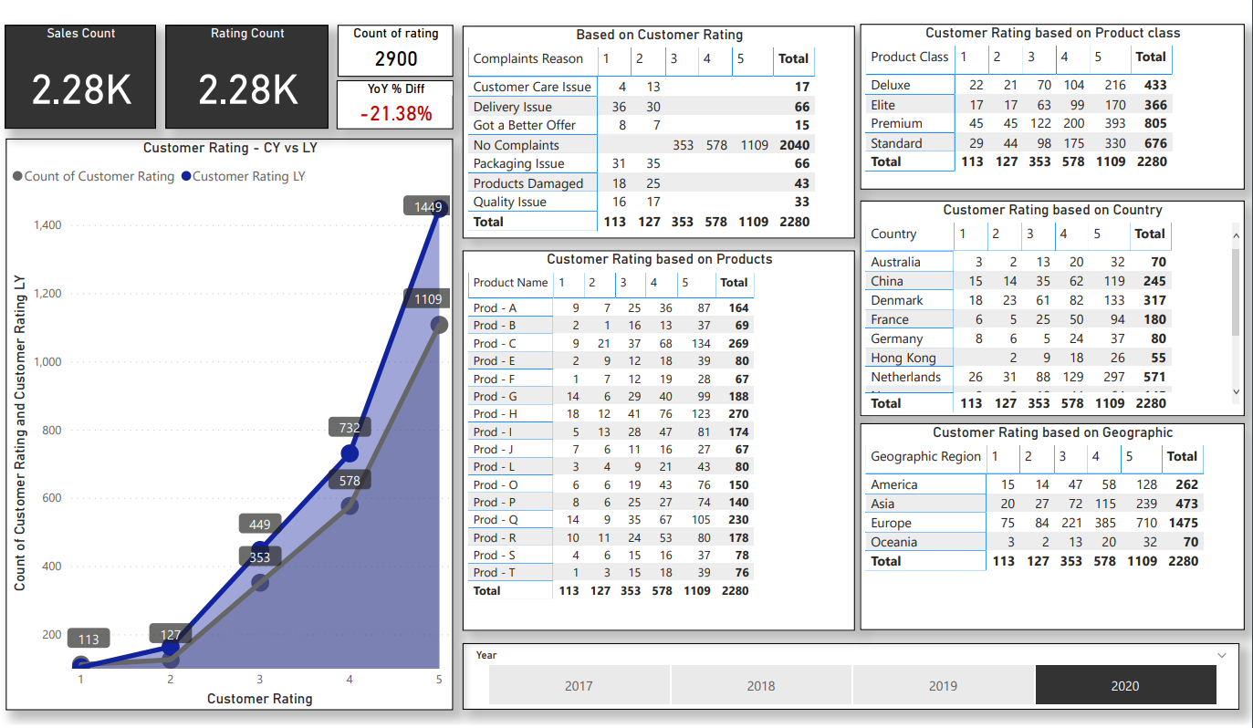

Slide 14
Customer Feedback
Customer Satisfaction
Overall customer satisfaction is 4.28 out of 5, which is a slight decrease from last year's 4.32.
The highest-rated product class is Deluxe with a rating of 4.67, followed by Premium at 4.63 and Standard at 4.26.
The lowest-rated product class is Basic with a rating of 3.89.
The most common reason for customer complaints is "Customer Care Issue", followed by "Delivery Issue" and "Got a Better Offer".
Customer satisfaction is highest in Australia at 4.83, followed by China at 4.72 and Denmark at 4.69.
Customer satisfaction is lowest in Netherlands at 4.02, followed by France at 4.12 and Germany at 4.18.

Slide 15
Customer Feedback
Sales
Total sales count is 2,280, which is up 36.45% year-over-year.
The top-selling product is Prod-B, followed by Prod-H and Prod-C.
Sales are growing in all regions except Asia, where sales are down 58.29% year-over-year.
The best-selling product class is Deluxe, but sales are down 12.85% year-over-year.
The fastest-growing product class is Premium, with sales up 98.09% year-over-year.
Other Insights
The number of new customers is up 1,643 year-over-year.
The most popular discount type is "No Discount," followed by "Clearance Sale" and "Coupons Sale."
The company is concentrated in the United States, Australia, and Switzerland.

Slide 16
Thank you!

